Slide 1
Reaching Clarity on Instructional Leadership

Slide 2
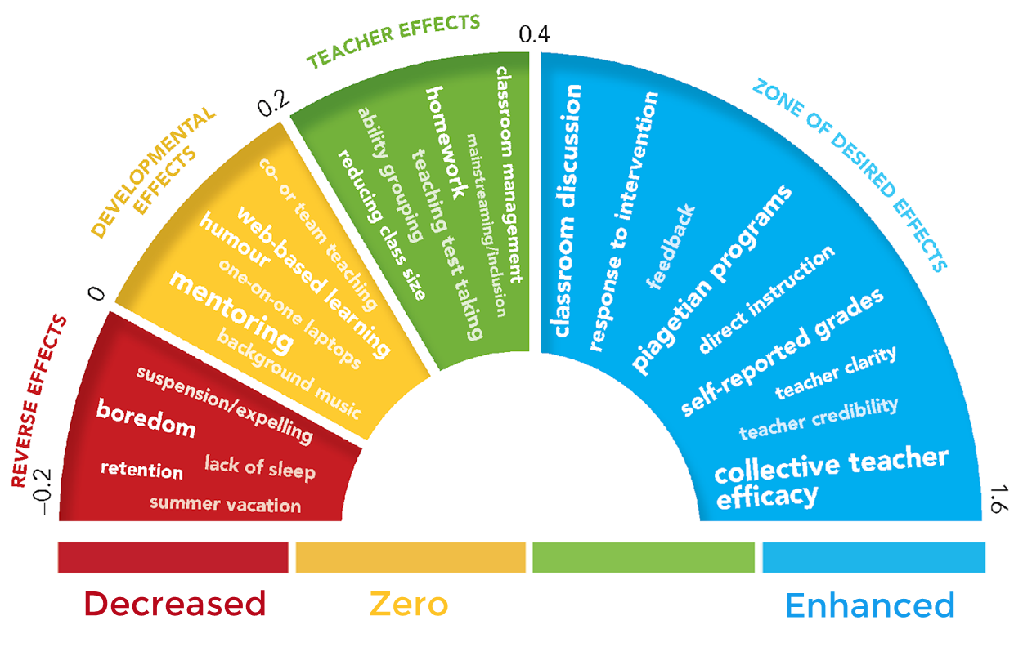
THE THERMOMETER OF IMPACT
Teacher Clarity
<-.4 -.3 -.2 -.1 0 .1 .2 .3 .4 .5 .6 .7 .8 .9 1.0 1.1 1.2
0.85

Slide 3
Universal Responses:
Micro-assessments That Propel Learning

Slide 4
A good rule of thumb:
Provide a universal response opportunity at least every 10 minutes.

Slide 7
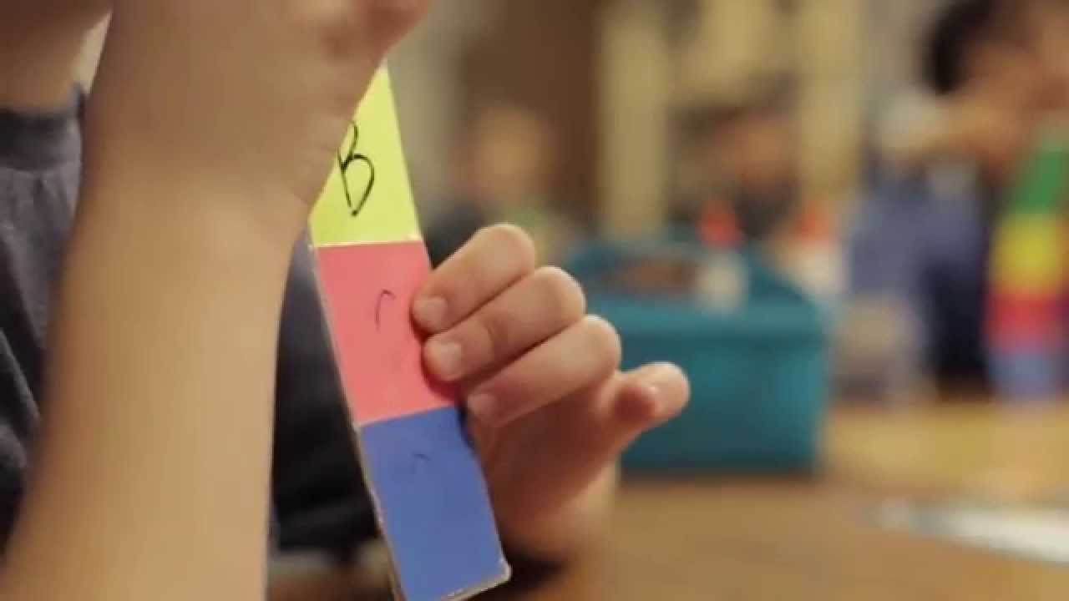
Response cards are associated with higher achievement on tests and quizzes, higher levels of participation, and lower levels of disruptive behavior, compared to individual hand raising to answer a question (Randolph, 2007).

Slide 8
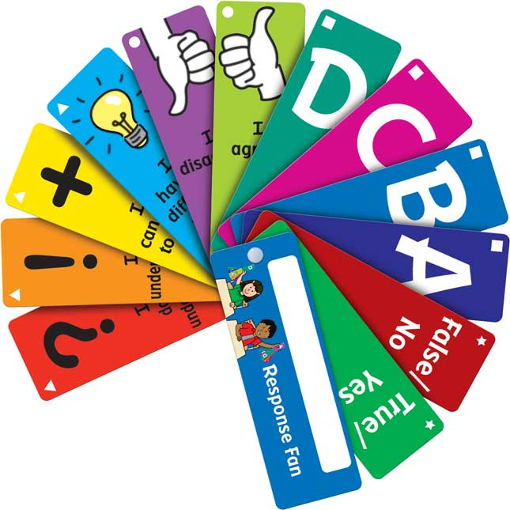
Preprinted response cards on a ring make it easier for students to find them.

Slide 9
Taking it Back and Moving Forward

Slide 10
Know your multigenerational workforce.
Maximize your immediacy.
Coordinate research-based systems of instruction.

Slide 11
Thank you!
www.fisherandfrey.com

